Slide 1
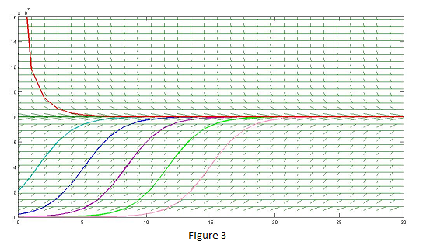







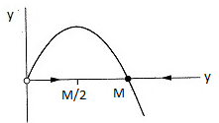
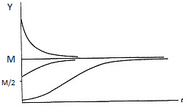
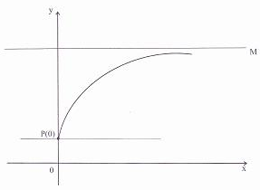









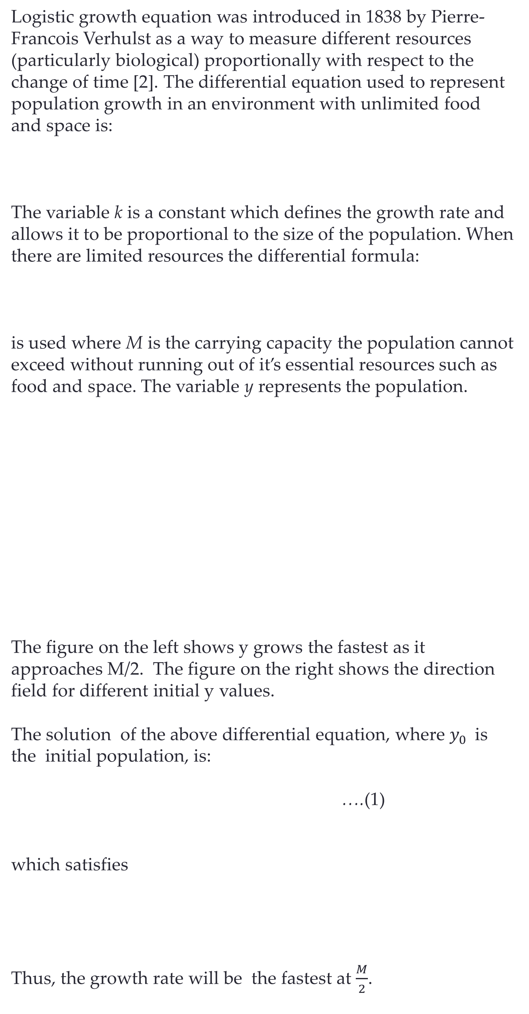
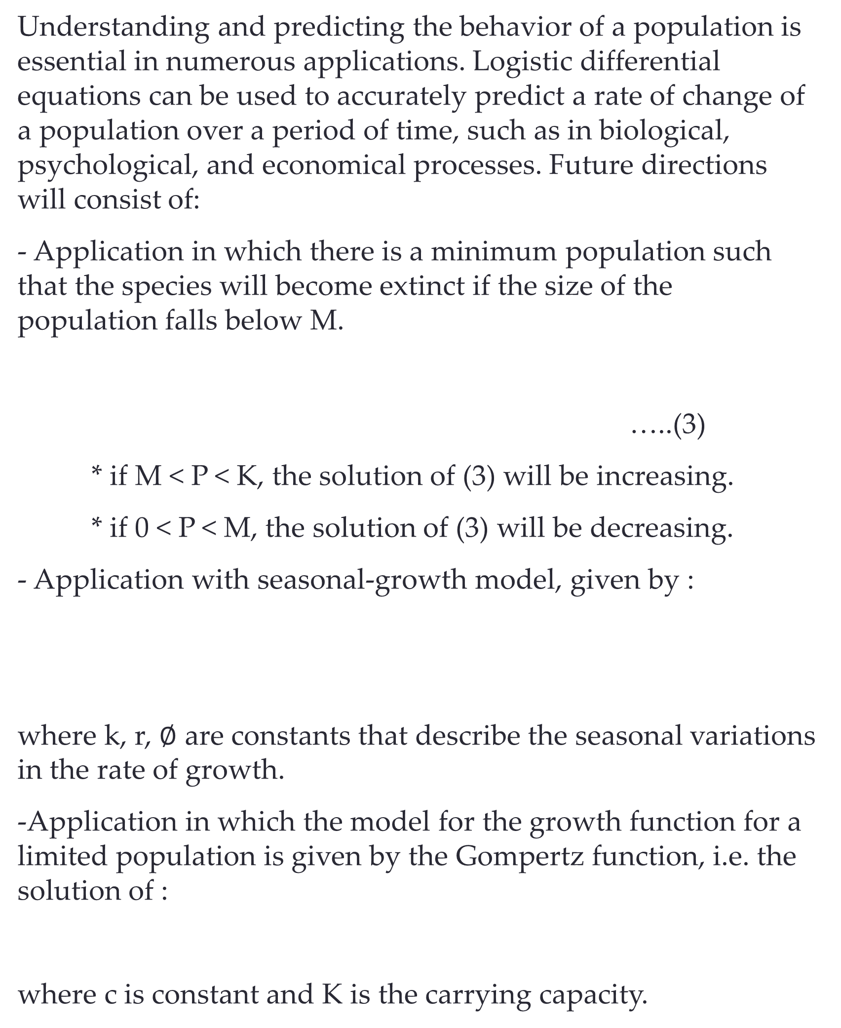
Mathematical Analysis and Applications of Logistic Differential Equation
Eva Arnold, Dr. Monika Neda
Department of Mathematical Sciences, University of Nevada Las Vegas 2011
Introduction
Application (cont.)
Application (cont.)
Conclusions and Future Directions
Logistic growth equation was introduced in 1838 by Pierre-Francois Verhulst as a way to measure different resources (particularly biological) proportionally with respect to the change of time [2]. The differential equation used to represent population growth in an environment with unlimited food and space is:
The variable k is a constant which defines the growth rate and allows it to be proportional to the size of the population. When there are limited resources the differential formula:
is used where M is the carrying capacity the population cannot
exceed without running out of it’s essential resources such as food and space. The variable y represents the population.
The figure on the left shows y grows the fastest as it approaches M/2. The figure on the right shows the direction field for different initial y values.
The solution of the above differential equation, where $y_{0 }$ is the initial population, is:
….(1)
which satisfies
Thus, the growth rate will be the fastest at $\frac{M}{2}$.
If M is the maximum level of performance of which the learner is capable, then the equation, ( with k a positive constant):
…………………… (2)
is a reasonable model for learning since RHS of (2) is always positive, so the level of performance P is increasing. As P gets close to M, dP/dt gets close to 0, that is, the performance levels off.
The solution is derived from
i.e.
and is:
The figure above shows the performance of someone learning a skill as a function of the training time t.
Understanding and predicting the behavior of a population is essential in numerous applications. Logistic differential equations can be used to accurately predict a rate of change of a population over a period of time, such as in biological, psychological, and economical processes. Future directions will consist of:
- Application in which there is a minimum population such that the species will become extinct if the size of the population falls below M.
…..(3)
* if M < P < K, the solution of (3) will be increasing.
* if 0 < P < M, the solution of (3) will be decreasing.
- Application with seasonal-growth model, given by :
where k, r, $∅$ are constants that describe the seasonal variations in the rate of growth.
-Application in which the model for the growth function for a limited population is given by the Gompertz function, i.e. the solution of :
where c is constant and K is the carrying capacity.
Figure 3 shows the direction field as the initial y0 value changes.
Prediction of World Population
The population in the world was about 5.3 billion in 1990. Birth rates in the 1990s range from 35 to 40 million per year and death rate rates from 15 to 20 million per year. Assume the carrying capacity for the world population is 100 billion.
The solution for the world population growth is:
with
Predictions with carrying capacity of 100 billion
In the year 2100: P(110) = 7.81 billion
In the year 2500: P(510) = 27.72 billion
Predictions with carrying capacity of 50 billion
In the year 2100: P(110) = 7.61 billion
In the year 2500: P(510) = 22.41 billion
Acknowledgements
Application in Biology
Special thanks to Yuri Sapolich for his time and help with the graphs and material concept. We thank to the Department of Mathematical Sciences for provided funds, as well.
We'd like to thank the Office of Institutional Analysis and Planning and to Janet Reiber, Director of College of Sciences Advising Center, for helping us with the enrollment data.
Biologists stocked a lake with 400 fish of one species and estimated the species ‘ carrying capacity in the lake to be 10,000. The number of the fish tripled in the first year.
Assuming that the size of the fish population satisfies the logistic equation, we find the expression for the size of the population after t years. Based on (1), with yo=400, y= 1200, M= 10000, and t=1, we get:
Prediction of UNLV Undergraduate
Student Population
The UNLV undergraduate student population was 20,842 in 2003. In 2004, it was 21,783. Assume the carrying capacity for the undergraduate student population is 500,000.
The solution for the UNLV undergraduate student population growth is:
with
References
[1] Stewart, James. Calculus: Concepts and Context. Brooks Cole, 1996. 584-94.
[2] Stewart, James. Essential Calculus: Early Transcendentals. BrooksCole Pub Co, 2006. 397-404.
[3] Strogatz, Steven. Nonlinear dynamics and Chaos: with applications to physics, biology, chemistry, and engineering. Westview Press, 1994. 21-24.
Application in Psychology
b) How long will it take for the population to increase to 5000?
Predictions with carrying capacity 500,000
In the year 2015: P(12) = 34,786
In the year 2025: P(22) = 52,550
In the year 2100: P(97) = 388,163
Predictions with carrying capacity 250,000
In the year 2015: P(12) = 33,802
In the year 2025: P(22) = 49,289
In the year 2100: P(97) = 219,723
Psychologists are interested in learning theory study - learning curves. A learning curve is the graph of a function P(t), the performance of someone learning a skill as a function of the training time t. The derivative dP/dt represents the rate at which performance improves.
For further information
If you have any questions or would like more information, the authors may be reached at Arnolde4@unlv.nevada.edu and Monika.Neda@unlv.edu.

