Slide 1
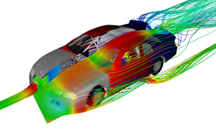

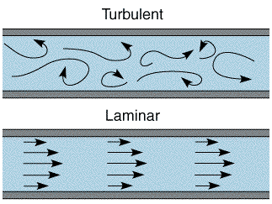



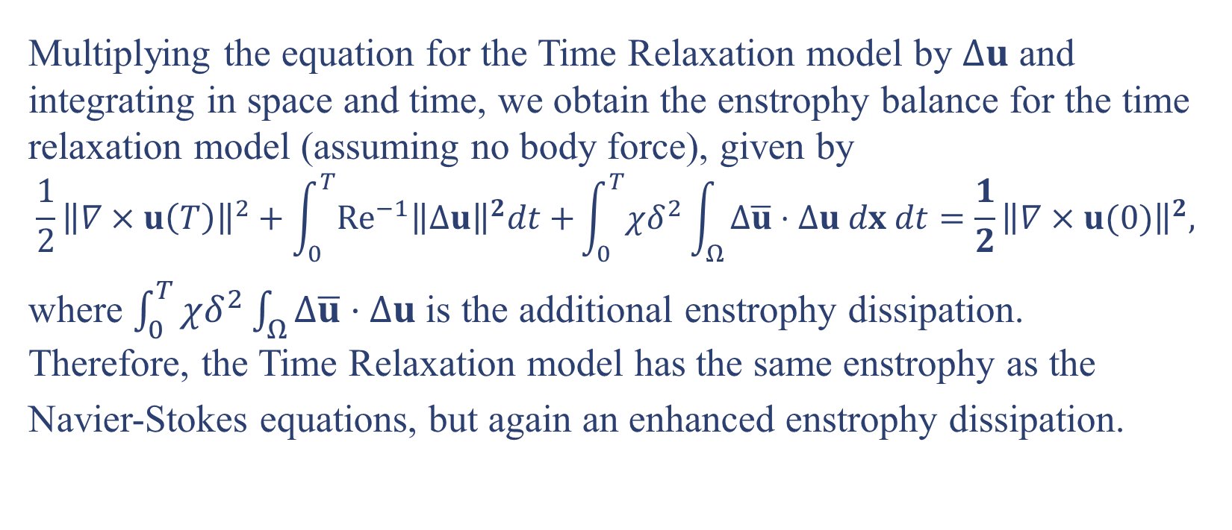
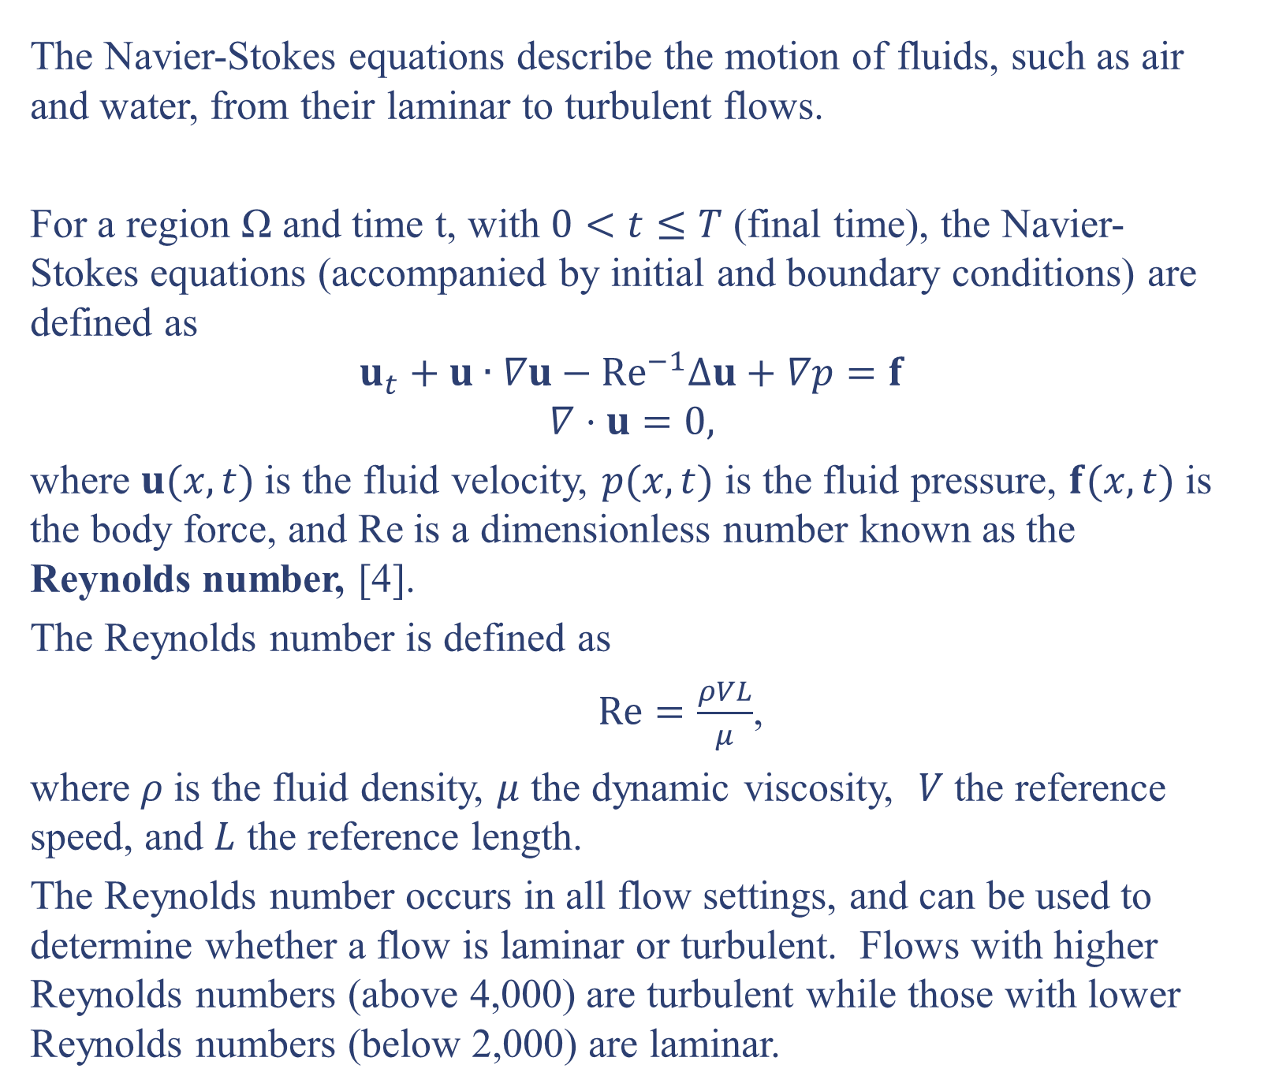
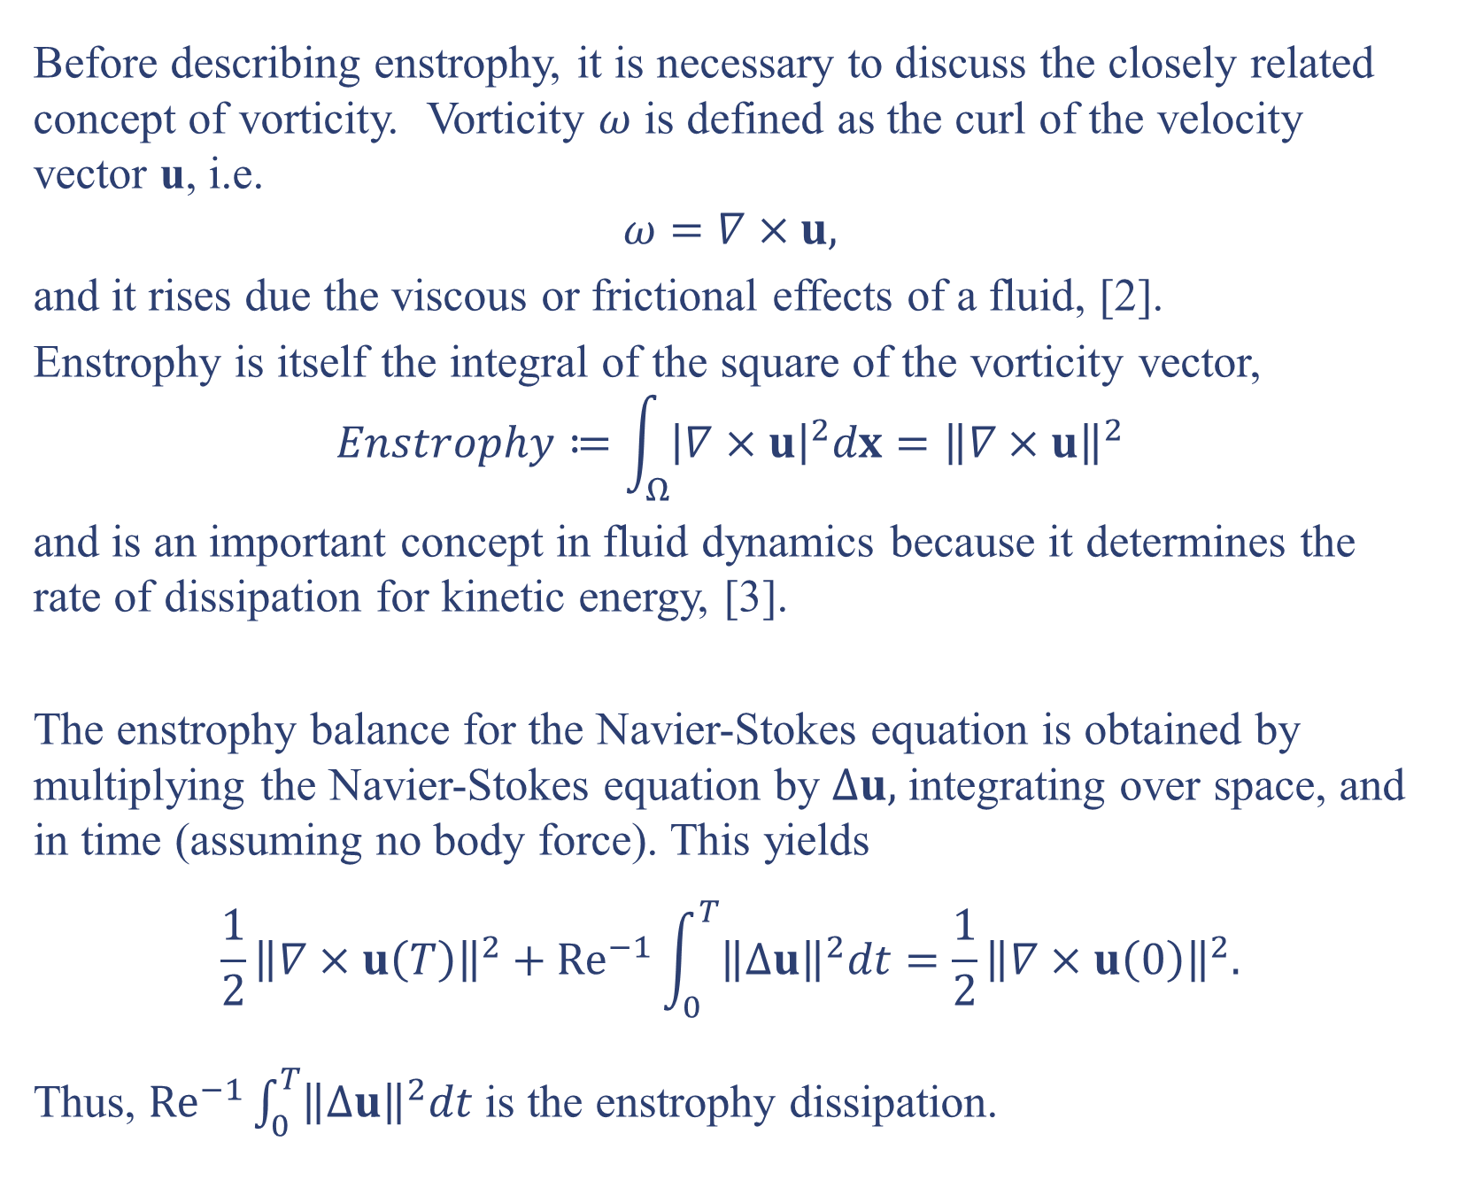
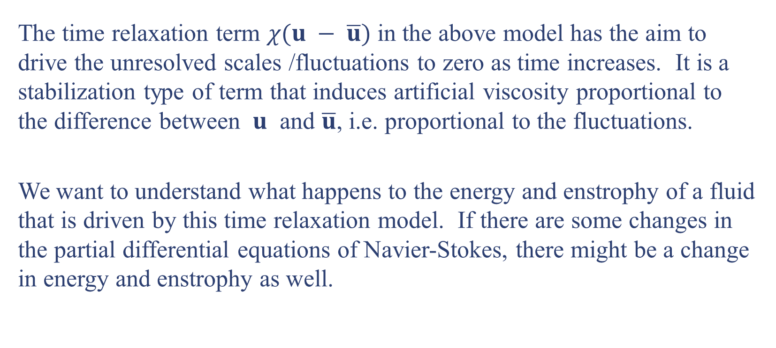
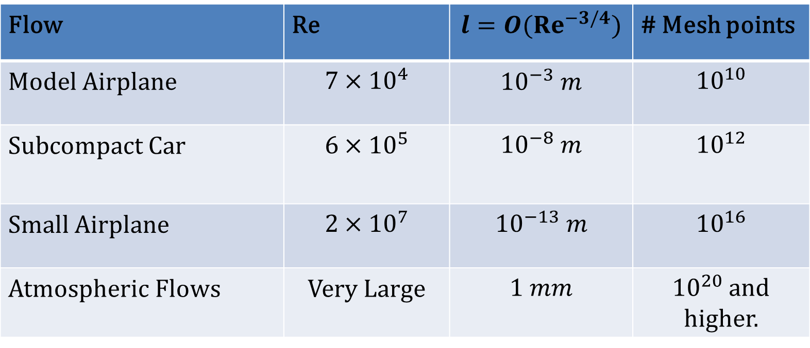
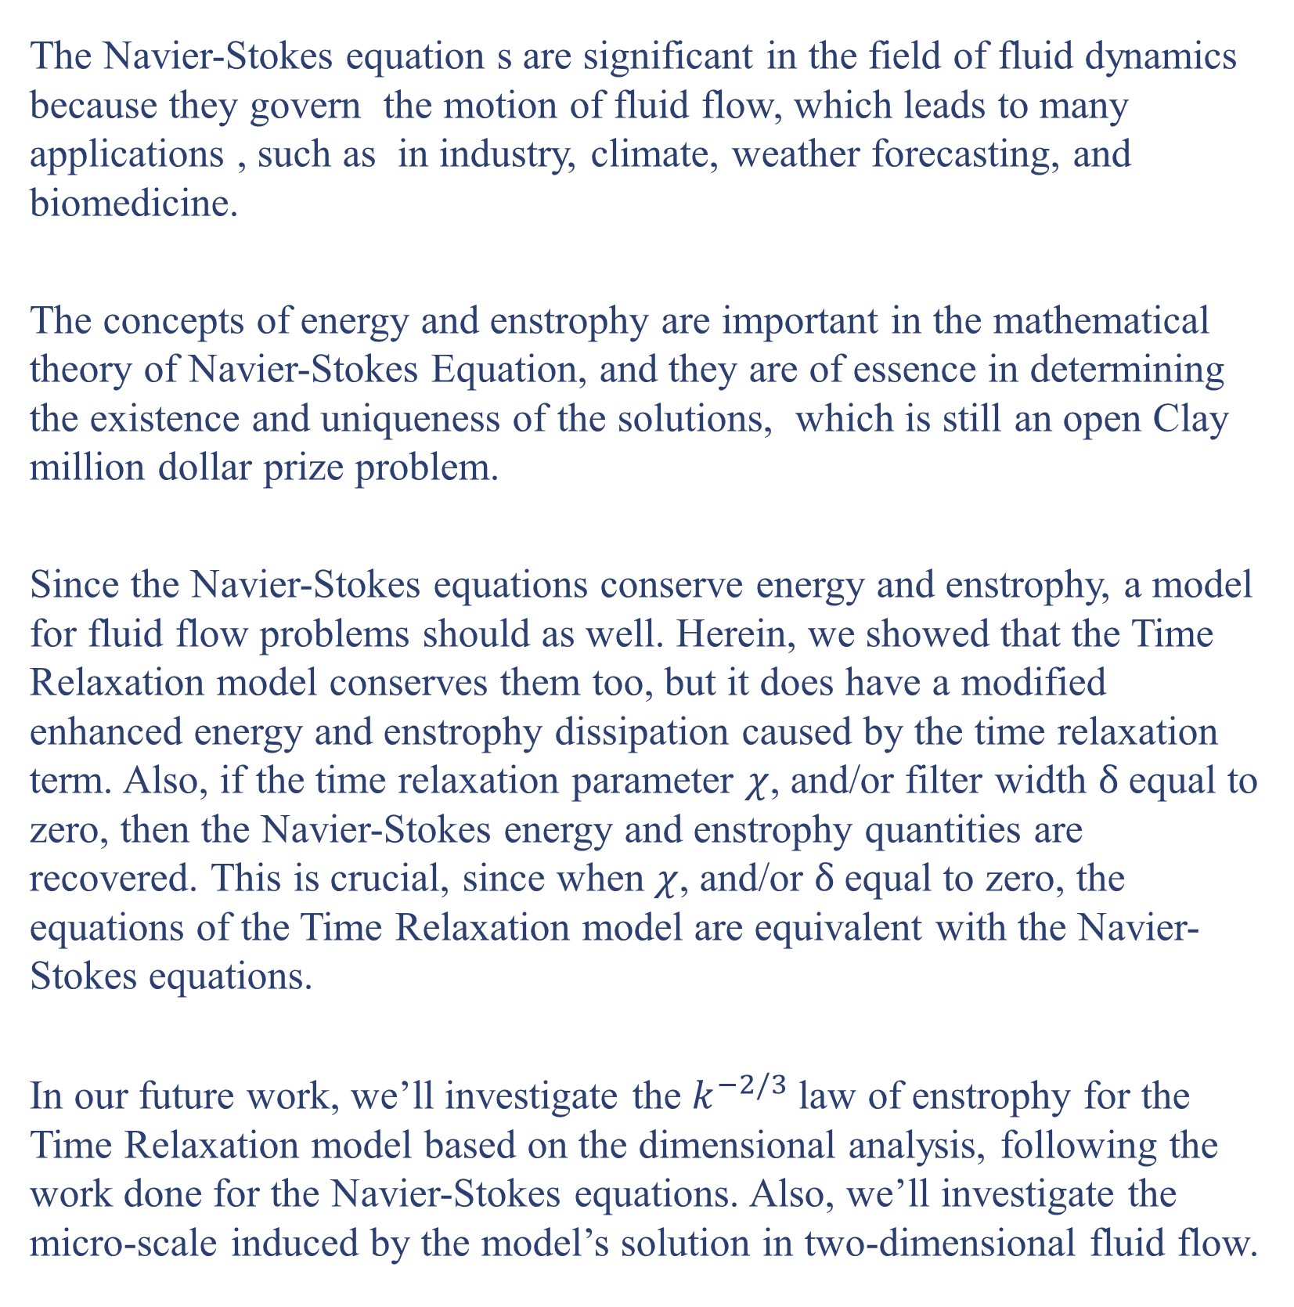
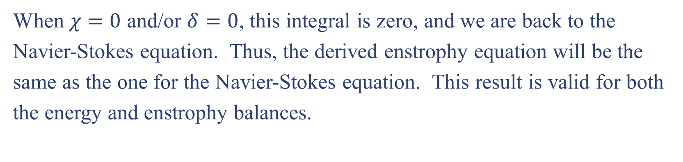
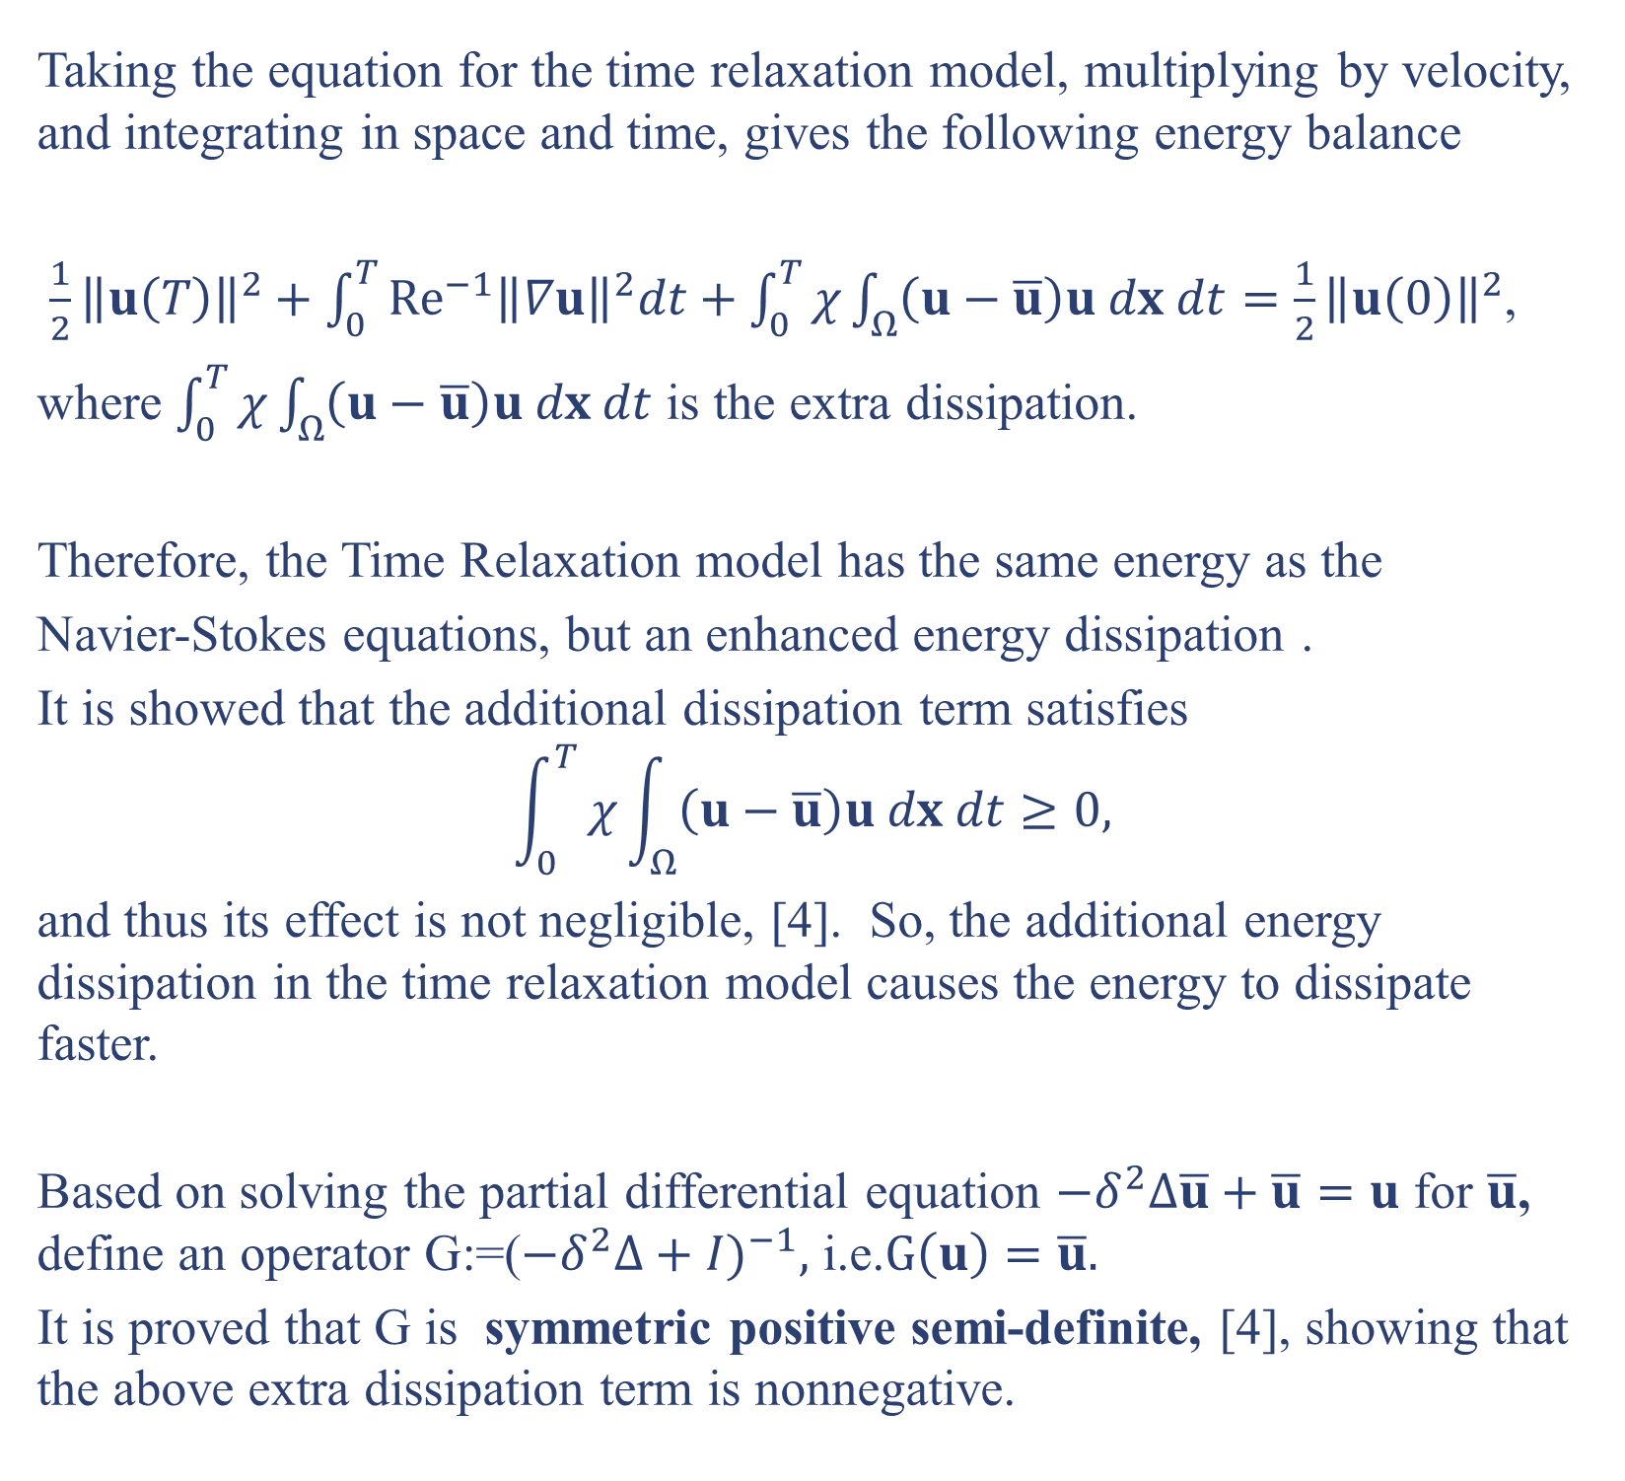
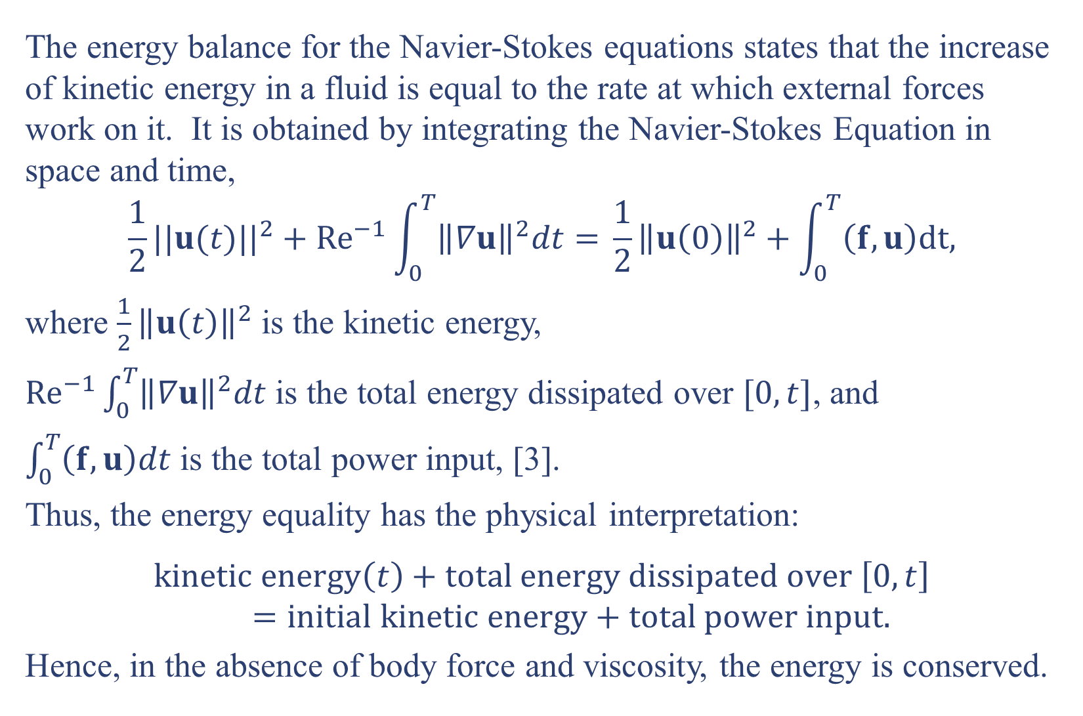
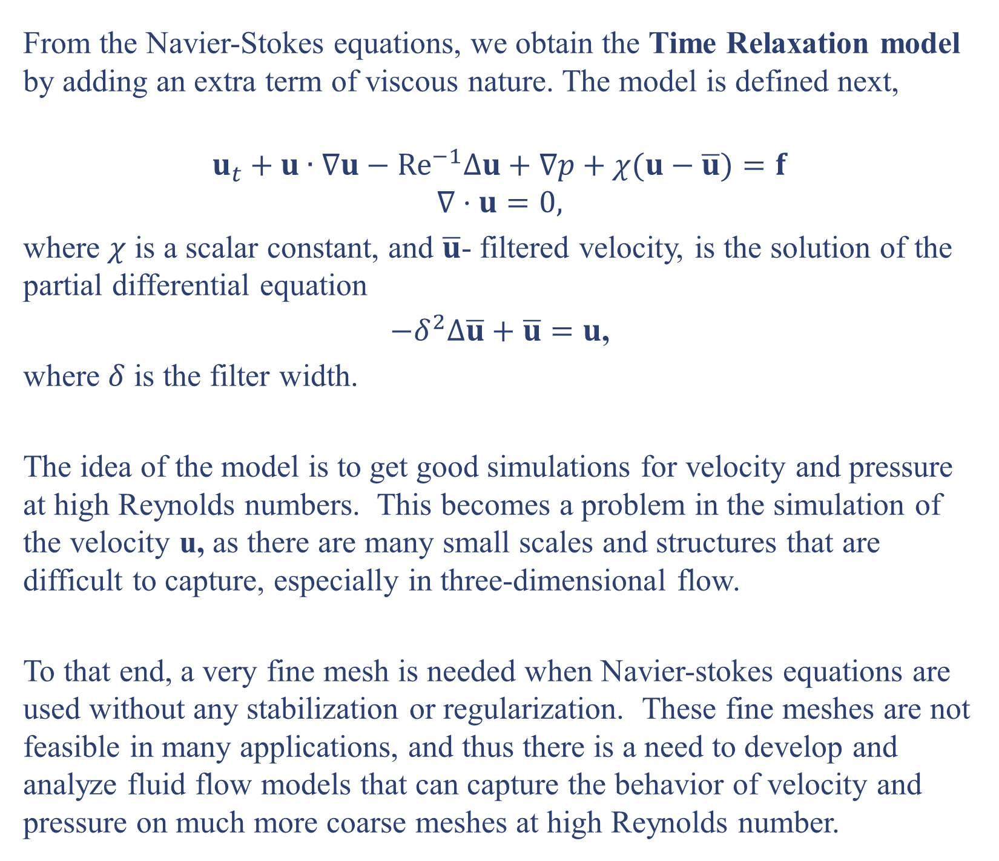
Energy and Enstrophy Investigations in Regularized Navier-Stokes Equations
Tahj Hill, Dr. Monika Neda
Department of Mathematical Sciences, University of Nevada, Las Vegas, 2013
Introduction
Energy
Fluid Dynamics is the study of fluids, their behavior in motion, and the forces that act on them. The field of computational fluid dynamics applies numerical methods and algorithms to solve fluid flow problems.
The governing equations for fluid flow are the Navier-Stokes equations,
originally derived by the scientist Claude-Louis Navier in 1823, with a more rigorous derivation by scientist George Gabriel Stokes in 1845, [1].
The energy balance for the Navier-Stokes equations states that the increase of kinetic energy in a fluid is equal to the rate at which external forces work on it. It is obtained by integrating the Navier-Stokes Equation in space and time,
$$\frac{1}{2}{||u(t)||}^{2}+Re^{−1}\int_{0}^{T}{{\left\|∇u\right\|}^{2}dt=} \frac{1}{2}{\left\|u\left(0\right)\right\|}^{2}+\int_{0}^{T}{\left(f,u\right)dt,}$$
where $\frac{1}{2}{\left\|u\left(t\right)\right\|}^{2}$ is the kinetic energy,
$Re^{−1}\int_{0}^{T}{{\left\|∇u\right\|}^{2}dt}$ is the total energy dissipated over $[0,t]$, and
$\int_{0}^{T}{\left(f,u\right)dt}$ is the total power input, [3].
Thus, the energy equality has the physical interpretation:
$$kinetic energy\left(t\right)+total energy dissipated over \left[0,t\right]=initial kinetic energy+total power input.$$
Hence, in the absence of body force and viscosity, the energy is conserved.
Flow | Re | $$l=O({Re}^{−3/4})$$ | # Mesh points
Model Airplane | $$7×{10}^{4}$$ | $${10}^{−3} m$$ | $${10}^{10}$$
Subcompact Car | $$6×{10}^{5}$$ | $${10}^{−8} m$$ | $${10}^{12}$$
Small Airplane | $$2×{10}^{7}$$ | $${10}^{−13} m$$ | $${10}^{16}$$
Atmospheric Flows | Very Large | $$1 mm$$ | ${10}^{20}$ and higher.
When $χ=0$ and/or $δ=0$, this integral is zero, and we are back to the
Navier-Stokes equation. Thus, the derived enstrophy equation will be the
same as the one for the Navier-Stokes equation. This result is valid for both
the energy and enstrophy balances.
Conclusions and Future Work
The Navier-Stokes equation s are significant in the field of fluid dynamics because they govern the motion of fluid flow, which leads to many applications , such as in industry, climate, weather forecasting, and biomedicine.
The concepts of energy and enstrophy are important in the mathematical theory of Navier-Stokes Equation, and they are of essence in determining the existence and uniqueness of the solutions, which is still an open Clay million dollar prize problem.
Since the Navier-Stokes equations conserve energy and enstrophy, a model for fluid flow problems should as well. Herein, we showed that the Time Relaxation model conserves them too, but it does have a modified enhanced energy and enstrophy dissipation caused by the time relaxation term. Also, if the time relaxation parameter $χ$, and/or filter width $δ$equal to zero, then the Navier-Stokes energy and enstrophy quantities are recovered. This is crucial, since when $χ$, and/or $δ$equal to zero, the equations of the Time Relaxation model are equivalent with the Navier-Stokes equations.
In our future work, we’ll investigate the $k^{−2/3}$ law of enstrophy for the Time Relaxation model based on the dimensional analysis, following the work done for the Navier-Stokes equations. Also, we’ll investigate the micro-scale induced by the model’s solution in two-dimensional fluid flow.
Table 1: The various length scales l and mesh points needed to analyze the given flows at high Reynolds numbers, [4].
The time relaxation term $χ(u − \overline{u})$ in the above model has the aim to drive the unresolved scales /fluctuations to zero as time increases. It is a stabilization type of term that induces artificial viscosity proportional to the difference between $u$ and $\overline{u}$, i.e. proportional to the fluctuations.
We want to understand what happens to the energy and enstrophy of a fluid that is driven by this time relaxation model. If there are some changes in the partial differential equations of Navier-Stokes, there might be a change in energy and enstrophy as well.
Enstrophy
Figure 1: A common application in computation fluid dynamics is the analysis of fluid flow around such a vehicle., taken from http://www.autoevolution.com/news-image/how-does-cfd-computational-fluid-dynamics-work-6400-1.html
Before describing enstrophy, it is necessary to discuss the closely related concept of vorticity. Vorticity $ω$ is defined as the curl of the velocity vector u, i.e.
$$ω=∇×u,$$
and it rises due the viscous or frictional effects of a fluid, [2].
Enstrophy is itself the integral of the square of the vorticity vector,
$$Enstrophy≔\int_{Ω}{{\left|∇×u\right|}^{2}dx}={\left\|∇×u\right\|}^{2}$$
and is an important concept in fluid dynamics because it determines the rate of dissipation for kinetic energy, [3].
The enstrophy balance for the Navier-Stokes equation is obtained by multiplying the Navier-Stokes equation by $∆u,$ integrating over space, and in time (assuming no body force). This yields
$$\frac{1}{2}{\left\|∇×u\left(T\right)\right\|}^{2}+{Re}^{−1}\int_{0}^{T}{{\left\|∆u\right\|}^{2}dt=\frac{1}{2}{\left\|∇×u\left(0\right)\right\|}^{2}.}$$
Thus, ${Re}^{−1}\int_{0}^{T}{{\left\|∆u\right\|}^{2}dt}$ is the enstrophy dissipation.
The Navier-Stokes Equation
The Navier-Stokes equations describe the motion of fluids, such as air and water, from their laminar to turbulent flows.
For a region Ω and time t, with $0<t≤T$ (final time), the Navier-Stokes equations (accompanied by initial and boundary conditions) are defined as
$$u_{t}+u∙∇u−Re^{−1}∆u+∇p=f$$
$$∇⋅u=0,$$
where $u(x,t)$is the fluid velocity, $p(x,t)$ is the fluid pressure, $f(x,t)$ is the body force, and Re is a dimensionless number known as the Reynolds number, [4].
The Reynolds number is defined as
$Re=\frac{ρVL}{μ}$,
where $ρ$is the fluid density, $μ$ the dynamic viscosity, $V$the reference speed, and $L$ the reference length.
The Reynolds number occurs in all flow settings, and can be used to determine whether a flow is laminar or turbulent. Flows with higher Reynolds numbers (above 4,000) are turbulent while those with lower Reynolds numbers (below 2,000) are laminar.
Energy Study for the Time Relaxation Model
Taking the equation for the time relaxation model, multiplying by velocity, and integrating in space and time, gives the following energy balance
$\frac{1}{2}{\left\|u\left(T\right)\right\|}^{2}+\int_{0}^{T}{{Re}^{−1}{\left\|∇u\right\|}^{2}dt+\int_{0}^{T}{χ\int_{Ω}{\left(u−\overline{u}\right)u dx dt=\frac{1}{2}{\left\|u\left(0\right)\right\|}^{2}}}}$,
where $\int_{0}^{T}{χ\int_{Ω}{\left(u−\overline{u}\right)u dx dt}}$ is the extra dissipation.
Therefore, the Time Relaxation model has the same energy as the
Navier-Stokes equations, but an enhanced energy dissipation .
It is showed that the additional dissipation term satisfies
$$\int_{0}^{T}{χ\int_{Ω}{\left(u−\overline{u}\right)u dx dt}}≥0,$$
and thus its effect is not negligible, [4]. So, the additional energy dissipation in the time relaxation model causes the energy to dissipate faster.
Based on solving the partial differential equation $−δ^{2}∆\overline{u}+\overline{u}=u$ for $\overline{u}$, define an operator G:=($−{δ^{2}∆+I)}^{−1},$ i.e.$G\left(u\right)=\overline{u}.$
It is proved that G is symmetric positive semi-definite, [4], showing that the above extra dissipation term is nonnegative.
Literature Cited
[1] Berselli, Luigi C., Traian Iliescu and William J. Layton. Mathematics of Large Eddy Simulation of Turbulent Flows. Heidelberg: Springer, 2006.
[2] Foias, C., O. Manley, R. Rosa and R. Temam. Encyclopedia of Mathematics and Its Applications: Navier-Stokes Equations and Turbulence. Cambridge: Cambridge University Press, 2001.
[3] Layton, William J. Introduction to the Numerical Analysis of Incompressible Viscous Flows. Philadelphia: Society of Industrial and Applied Mathematics, 2008.
[4] Layton, William J. and Leo Rebholz. Approximate Deconvolution Models of Turbulence: Analysis, Phenomenology and Numerical Analysis. Heidelberg: Springer 2010.
Time Relaxation Model
From the Navier-Stokes equations, we obtain the Time Relaxation model by adding an extra term of viscous nature. The model is defined next,
$$u_{t}+u∙∇u−Re^{−1}∆u+∇p+χ(u−\overline{u})=f$$
$$∇⋅u=0,$$
where $χ$ is a scalar constant, and $\overline{u}$- filtered velocity, is the solution of the partial differential equation
$−δ^{2}∆\overline{u}+\overline{u}=u$,
where $δ$ is the filter width.
The idea of the model is to get good simulations for velocity and pressure at high Reynolds numbers. This becomes a problem in the simulation of the velocity u, as there are many small scales and structures that are difficult to capture, especially in three-dimensional flow.
To that end, a very fine mesh is needed when Navier-stokes equations are used without any stabilization or regularization. These fine meshes are not feasible in many applications, and thus there is a need to develop and analyze fluid flow models that can capture the behavior of velocity and pressure on much more coarse meshes at high Reynolds number.
Acknowlegements
Enstrophy Study for the Time Relaxation Model
Special thanks to Dr. Neda, for her research support and detailed information on the subjects of energy, enstrophy, and the time relaxation model.
We also thank to the Department of Mathematical Sciences for provided funds.
Multiplying the equation for the Time Relaxation model by $∆u$ and integrating in space and time, we obtain the enstrophy balance for the time relaxation model (assuming no body force), given by
$$\frac{1}{2}{\left\|∇×u\left(T\right)\right\|}^{2}+\int_{0}^{T}{{Re}^{−1}{\left\|∆u\right\|}^{2}dt+}\int_{0}^{T}{χδ^{2}}\int_{Ω}{∆\overline{u}⋅∆u dx dt=\frac{1}{2}{\left\|∇×u(0)\right\|}^{2},}$$
where $\int_{0}^{T}{χδ^{2}}\int_{Ω}{∆\overline{u}⋅∆u}$ is the additional enstrophy dissipation. Therefore, the Time Relaxation model has the same enstrophy as the
Navier-Stokes equations, but again an enhanced enstrophy dissipation.
Contact
For any questions and further information, the authors may be contacted at hillt12@unlv.nevada.edu and Monika.Neda@unlv.edu.
Figure 2: Laminar versus turbulent flows, taken from http://blog.nialbarker.com/252/slow_is_faster
Notation: For $w,$ ${\left\|w\right\|}^{2}=\int_{Ω}{{\left|w\right|}^{2}}dx=(w,w)$.

