Slide 1
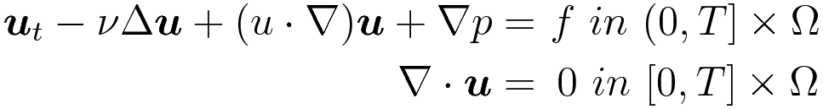
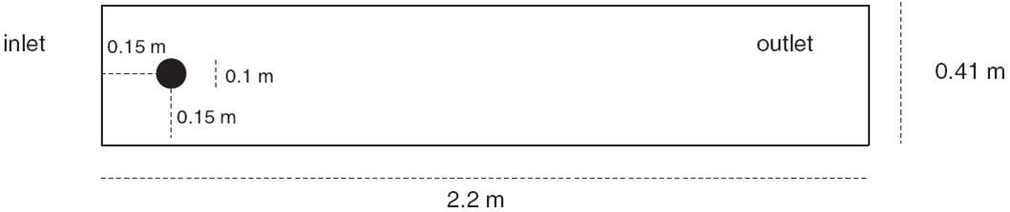
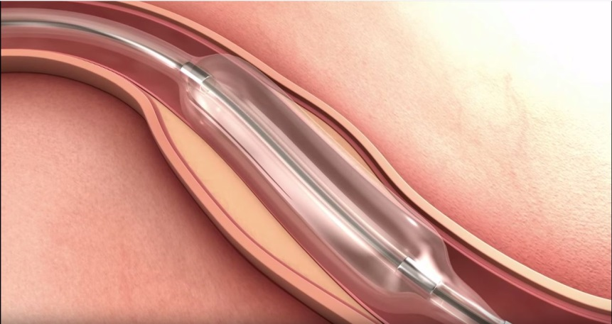
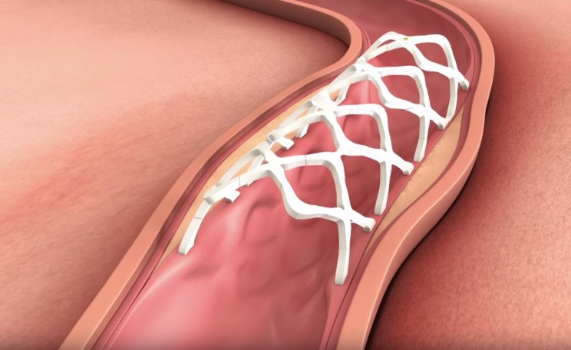
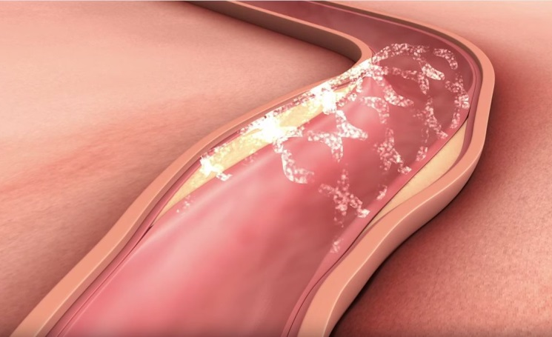
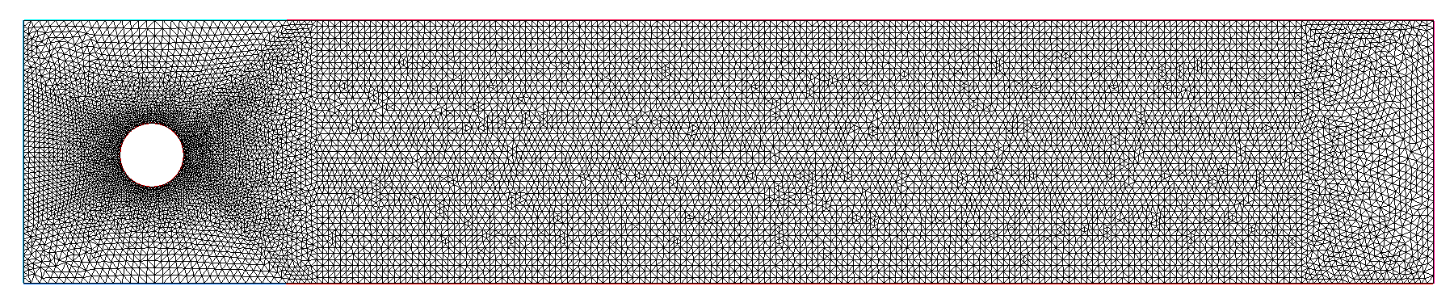


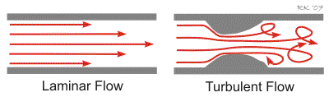

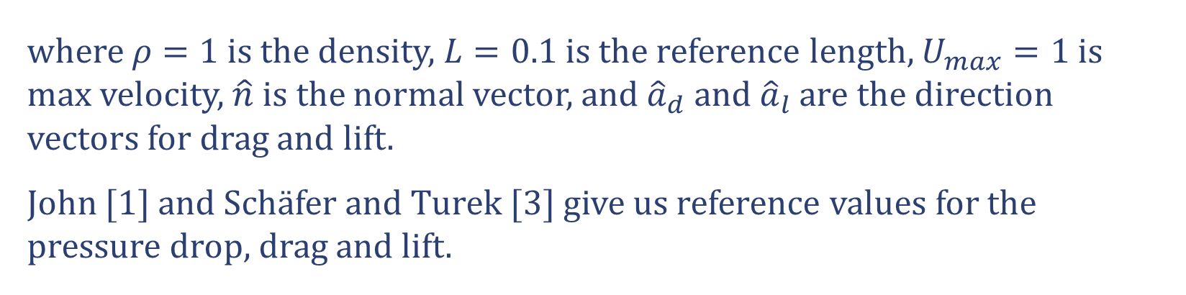


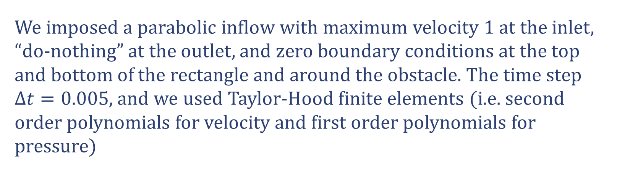

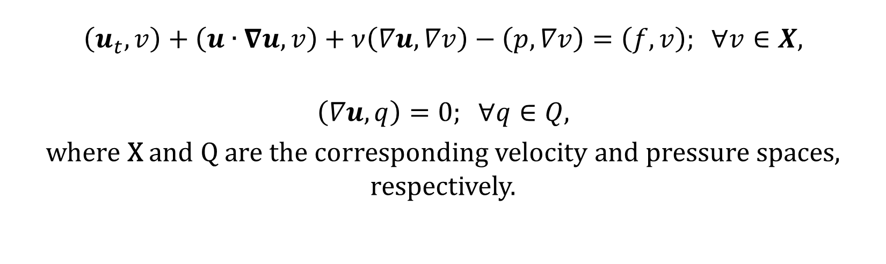
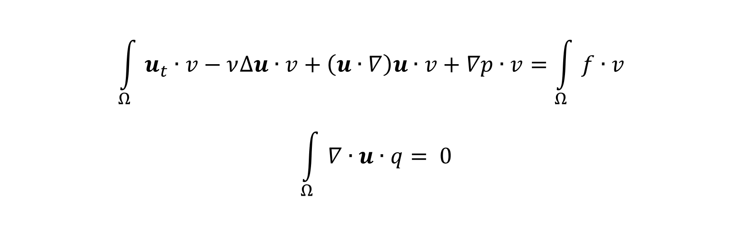
Applications and Computations of Fluid Flow Problems
Jonathan Kim, Dr. David Costa, Dr. Monika Neda, Dr. Paul Schulte
University of Nevada, Las Vegas
INTRODUCTION
NAVIER-STOKES EQUATIONS AND DERIVATIONS
COMPUTATIONAL SETUP
Fluid dynamics is the study of fluid flow and it’s properties in motion. Notable applications of fluid dynamics include, but are not limited to, calculating forces and moments on aircraft, calculating the mass flow rate of petroleum through pipes, and predicting weather conditions and patterns.
The governing equations of fluid dynamics are the Navier-Stokes equations (NSE) introduced by Claude-Louis Navier and George Gabriel Stokes circa 1927. These equations provide a fundamental description of the movement of fluids and have been applied to a variety of computational fluid problems in biology including flow through circulatory systems in organisms as well as fluid transport structures in plants.
In plant biology, Computational Fluid Dynamics (CFD) can be use to analyze capillary action and the dispersion of water or nutrients in either xylem, phloem, or roots. Many plants have a specialized transport tissue called the xylem that is made up of individual cells containing a variety of complicated structures through which the flow must pass from one cell to the next. Solutions of the Navier-Stokes equations have provided insight into the role of these structures based on the creation of realistic 3D models of the cells, cf. [4].
In the human circulatory system, CFD is applied in order to measure fluids such as blood, water, or CO₂ circulating throughout the body. Some CFD biomedical applications include artificial organ design, vessel graft evaluation, and life support systems.
In artificial organ design, the flow of substances would have to closely match that of the natural organ in order to ensure processes such as diffusion and advection match the original.
Biomedical engineers have designed stents for arteries by numerically analyzing blood flow. Generally, blood flow in the body is laminar but plaque and narrow passages can cause turbulence. Thus, it is important to design stents that induce the least amount of turbulence. The following illustrations by Arterial Remodeling Technologies provide an exceptional example:
From left to right, we observe that a plaque accumulated artery is being enlarged for stent insertion. A scaffolding stent is then expanded to the enlarged area to temporarily reinforce the enlargement of the artery. In simulations, CFD can be applied to measure if laminar flow is closely obtained in order to determine whether or not patients need to undergo further operations. These kinds of minimally invasive treatments dramatically reduce recovery time and provide a cost-benefit to the patient.
Doctors can hear turbulence through their stethoscopes. Turbulence is indicative of diseased and narrowed (stenotic) arteries (see figure above), and across stenotic heart valves.
NSE have numerous applications, but from the theoretical side the equations are still not fully understood. The existence of the strong solution is yet to be proven and is considered a million-dollar millennium problem by the Clay Mathematics Institute. Despite current theoretical difficulties, running simulated environments on computers reveals insights for applications that can be implemented in
the future.
We begin with the classical Navier-Stokes equations:
where u is the fluid velocity, p is the pressure, ν is the kinematic viscosity, f is the body force, T is the final time, and Ω is the domain of interest.
First equation represents the conservation of momentum and the second one is the conservation of mass.
These equations can be multiplied by known test functions (that satisfy specific properties), namely $“v ” and “q ”,$and can be integrated over the domain $Ω$ as shown below and demonstrated in details in [2]:
Using Green’s formula, we can transform and simplify these equations to obtain the Weak/Variational Formulation:
From the Weak/Variational formulation, we are able to obtain the Finite Element formulation. This formulation can then be used to numerically obtain the finite element solution of the Navier-Stokes equations. The time interval $(0,T]$is discretized, such that $tn = n∗Δt$, with $Δt$ being the step size in time, $n=0,1,2,…$ . A mesh based on Delaunay triangulation is constructed on the domain $Ω$ , depicted below in Fig. 3.
Fig. 3 Mesh
The Finite Element algorithm is:
Given velocity u^{n} and pressure p^{n} at the previous time step t^{n}, find u^{n+1} and p^{n+1} in the corresponding finite element spaces, $X_{h}$ and $Q_{h}$, for the current time step t^{n+1}
This algorithm is based on the Crank-Nicolson second order in time discretization.
The domain is a rectangle of size 2.2m x 0.41m, with a circular obstacle measuring a diameter of 0.1m, given in Fig. 4.
Fig. 6 Drag profile
Fig. 7 Lift profile
Fig. 4 Domain
We imposed a parabolic inflow with maximum velocity 1 at the inlet, “do-nothing” at the outlet, and zero boundary conditions at the top and bottom of the rectangle and around the obstacle. The time step $Δt=0.005$, and we used Taylor-Hood finite elements (i.e. second order polynomials for velocity and first order polynomials for pressure)
Fig. 8 Pressure difference profile
$$\begin{aligned}\int_{Ω}{u_{t}∙v−ν∆u∙v+\left(u∙∇\right)u∙v+∇p∙v=\int_{Ω}{f∙v} } \\ \int_{Ω}{∇∙u∙q}&= 0\end{aligned}$$
Based on their work, we conclude that the development of the drag and lift coefficients in time presented in Fig. 6 and 7, is successful. Fig. 8 presents the correct data for the pressure difference/drop on the circular obstacle immersed in the fluid.
CONCLUSIONS
We presented the Navier-Stokes equations and their numerous applications. Next, a numerical algorithm is stated based on continuous finite element discretization in space and Crank-Nicolson method in time.
We successfully simulated the development of the flow around an obstacle on the time interval [0,8]. The computations in time of the drag and lift coefficients and pressure drop on the obstacle immersed in the fluid using the finite element approach are presented too.
$\left(u_{t},v\right)+\left(u∙∇u,v\right)+ν\left(∇u,∇v\right)−\left(p,∇v\right)=\left(f,v\right); ∀v∈X$,
$$\left(∇u,q\right)=0; ∀q∈Q,$$
where X and Q are the corresponding velocity and pressure spaces, respectively.
ACKNOKWLEDGEMENTS
This benchmark problem was possible due to the detailed materials provided by Drs. John, Schäfer, and Turek. This research was generously supported by NSF and computational power provided by the National Supercomputing Center for Energy and the Environment. Special thanks to Drs. David Costa and Paul Schulte for fostering interest and leading the Biomathematics Program at the University of Nevada, Las Vegas.
Fig. 1 Stent insertion in artery (http://art-stent.com/?p=52)
Fig. 5 Velocity field at time t=2s, 4s, 5s, 6s, 7s, and 8s.
The background color represents the velocity magnitude.
REFERENCES
The formation of the Von Karman vortex street in Fig. 5 is a good, simple criterion for success of this simulation, but another important one is accurate calculation of the pressure drop (Δp) across the obstacle, as well as the drag (c_{d}) and lift (c_{l}) coefficients. The pressure drop is defined simply as the difference between the pressures at the right and left edges of the circle from the domain. For the drag and lift, we integrate around the circle.
[1] V. John. Reference values for drag and lift of a two-dimensional time-dependent flow around a cylinder. International Journal for Numerical Methods in Fluids, 44:777–788, 2004.
[2] W. Layton, “Approximating Time-Dependent Flows,” in Introduction to the Numerical Analysis of Incompressible Viscous Flows. Philadelphia: SIAM, 2008, pp. 151-154.
[3] M. Schäfer and S. Turek. The benchmark problem `flow around a cylinder’. Notes on Numerical Fluid Mechanics, 52:547–566, 1996. In Flow Simulation with High-Performance Computers II.
[4] P. J. Schulte, U.G. Hacke, A.L. Schoonmaker. Pit membrane structure is highly variable and accounts for a major resistance to water flow through tracheid pits in stems and roots of two boreal conifer species. New Phytologist, 208:102-113, 2015.
$$\left(\frac{u_{h}^{n+1}−u_{h}^{n}}{Δt}, v_{h}\right)+\left(u_{h}^{n+\frac{1}{2}}∙∇u_{h}^{n+\frac{1}{2}}, v_{h}\right)+ν\left(∇u_{h}^{n+\frac{1}{2}},∇v_{h}\right)−\left(p_{h}^{n+\frac{1}{2}}, ∇v_{h}\right)=\left(f^{n+\frac{1}{2}}, v_{h}\right); ∀v_{h}∈X_{h},$$
$$\left(∇∙u_{h}^{n+\frac{1}{2}}, q_{h}\right)=0; ∀q_{h}∈Q_{h},$$
Fig. 2 Types of Flow (http://www.cvphysiology.com/Hemodynamics/H007.htm)
$$c_{d}\left(t\right)= \frac{2}{ρLU_{max}^{2}}\int_{C}{\hat{n} ∙\left(pI−ν∇u\right)∙{\hat{a}}_{d}} \\ c_{l} \left(t\right)= \frac{2}{ρLU_{max}^{2}}\int_{C}{\hat{n}∙\left(pI−ν∇u\right)∙{\hat{a}}_{l} }$$
$$where u^{n+1}=u\left(t^{n+1}\right), u^{n+\frac{1}{2}}=\frac{u^{n+1}−u^{n}}{2}$$
where $ρ=1$ is the density, $L=0.1$ is the reference length, $U_{max}=1$ is max velocity, $\hat{n}$ is the normal vector, and ${\hat{a}}_{d}$ and ${\hat{a}}_{l}$ are the direction vectors for drag and lift.
John [1] and Schäfer and Turek [3] give us reference values for the pressure drop, drag and lift.
CONTACT
For any questions or more information, the authors may be reached at KimJ170@unlv.nevada.edu, Costa@unlv.nevada.edu, Monika.Neda@unlv.edu, and Paul.Schulte@unlv.edu.

