Slide 1
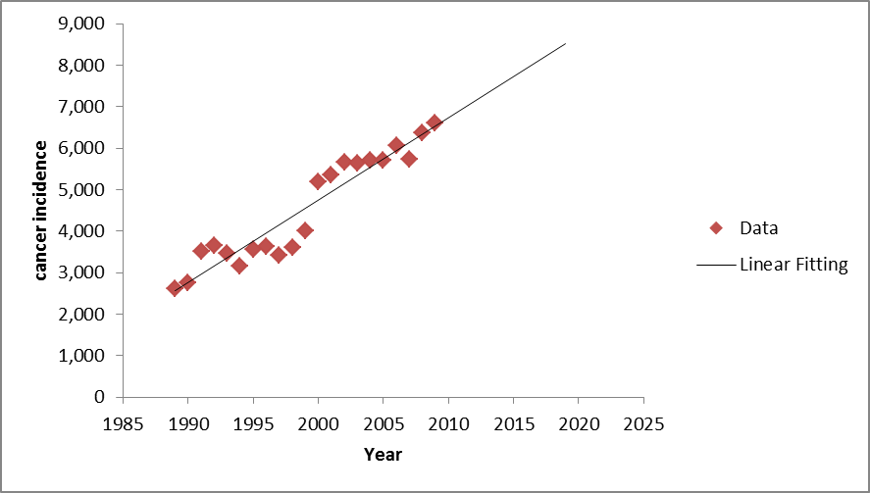
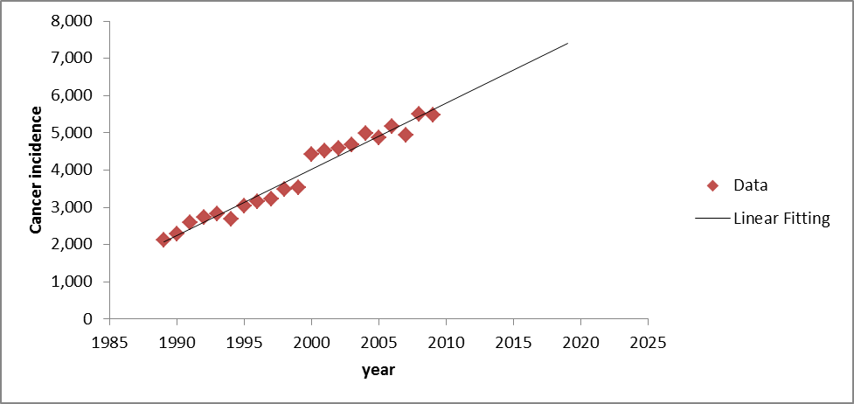
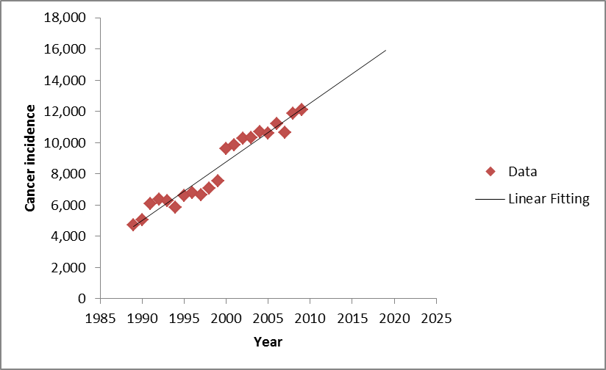
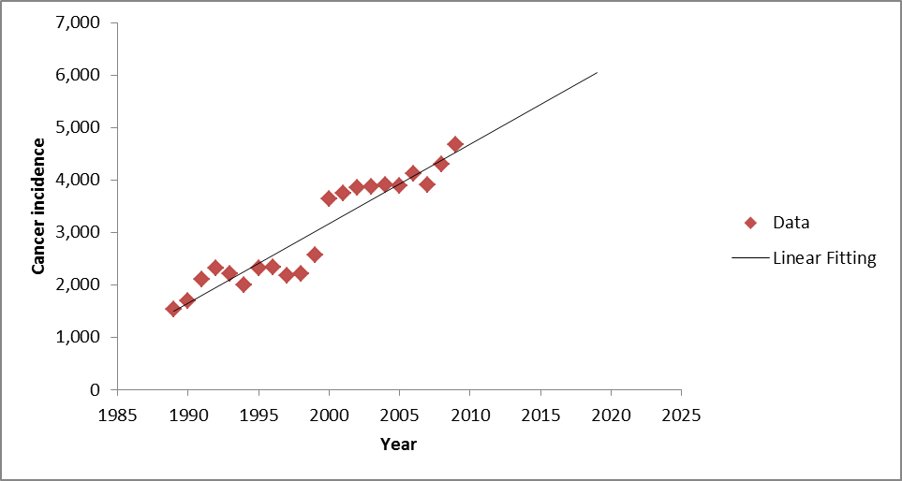
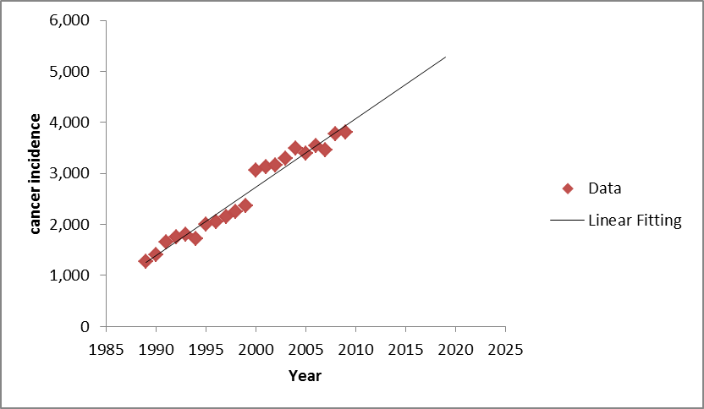
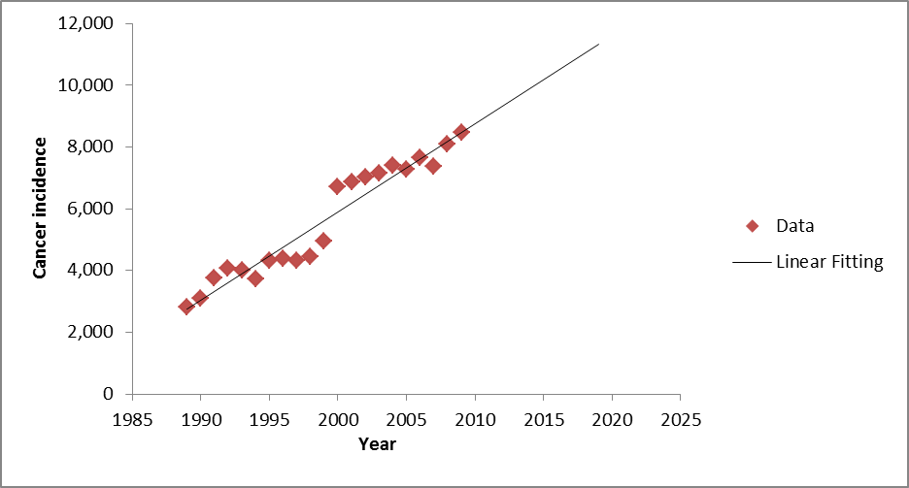

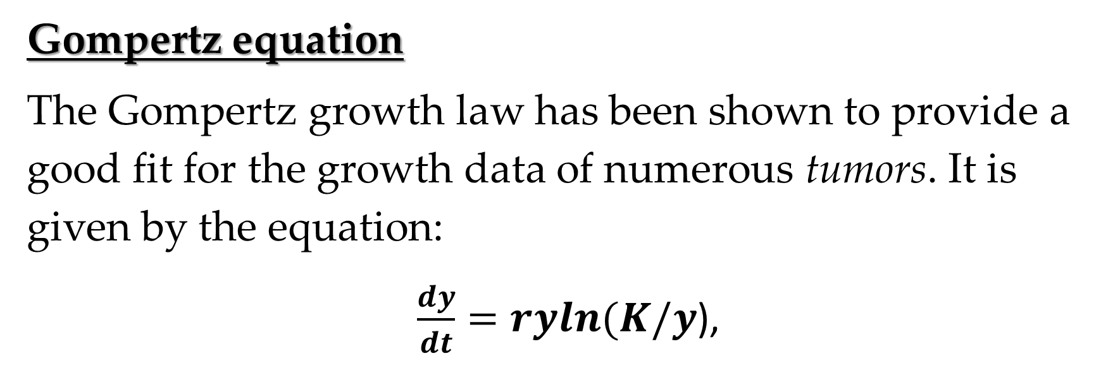
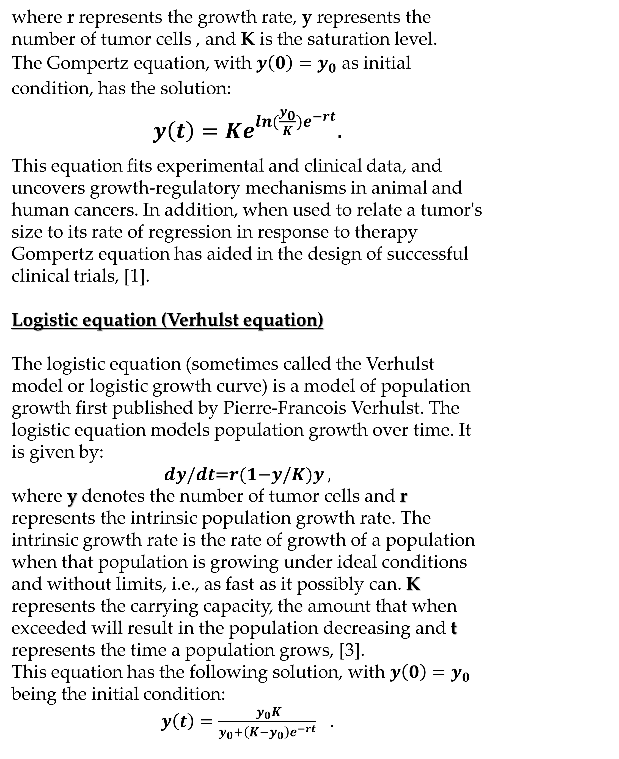
Modeling and Prediction of Cancer Growth
Louisa Owuor, Dr. Monika Neda
Department of Mathematical Sciences, University of Nevada Las Vegas, 2013
INTRODUCTION
Modeling tumor growth and treatment has become one of the leading research areas since cancer is a major cause of death in our modern society. Predicting tumor growth requires a multidisciplinary work. The latest trends also include the intellectual energy of scientists working in the field of mathematics and statistics collaborating closely with biologists and clinicians[1].
The Gompertz equation and the logistic equation have been used to give insight within cancer research that have significant impact on epidemiological studies and clinical practice, [2].
Data and Predictions for Nevada
Total Cancer Incidences
Male Cancer Incidences
Female Cancer Incidences
Linear fitting is given by:
y=196.86t-392613
Linear fitting is given by:
y=177.44t-350853
Linear fitting is given by:
y=376.18t-743582
Gompertz equation
The Gompertz growth law has been shown to provide a good fit for the growth data of numerous tumors. It is given by the equation:
$\frac{dy}{dt}=ryln(K/y$),
Predictions
Predictions
Predictions
Data and Predictions for Clark County
Total Cancer Incidences
where r represents the growth rate, y represents the number of tumor cells , and K is the saturation level.
The Gompertz equation, with ${y\left(0\right)=y}_{0}$ as initial condition, has the solution:
$y\left(t\right)=Ke^{ln(\frac{y_{0}}{K}{)e}^{−rt}}$.
This equation fits experimental and clinical data, and uncovers growth-regulatory mechanisms in animal and human cancers. In addition, when used to relate a tumor's size to its rate of regression in response to therapy Gompertz equation has aided in the design of successful clinical trials, [1].
Logistic equation (Verhulst equation)
The logistic equation (sometimes called the Verhulst model or logistic growth curve) is a model of population growth ﬁrst published by Pierre-Francois Verhulst. The logistic equation models population growth over time. It is given by:
𝒅𝒚/𝒅𝒕=𝒓(𝟏−𝒚/𝑲)𝒚 ,
where y denotes the number of tumor cells and r represents the intrinsic population growth rate. The intrinsic growth rate is the rate of growth of a population when that population is growing under ideal conditions and without limits, i.e., as fast as it possibly can. K represents the carrying capacity, the amount that when exceeded will result in the population decreasing and t represents the time a population grows, [3].
This equation has the following solution, with ${y\left(0\right)=y}_{0}$ being the initial condition:
$y\left(t\right)=\frac{ y_{0}K}{y_{0}+\left(K−y_{0}\right)e^{−rt}}$ .
Male Cancer Incidences
Female Cancer Incidences
Linear fitting is given by:
y=151.74t-300315
Linear fitting is given by:
y=134.29t-256844
Linear fitting is given by:
y=286.05t-566192
Predictions
Predictions
Predictions
Conclusions and Future Directions
Acknowledgments
References
In our study, we performed linear fitting based on least-squares method for all the different type of data, and in all the above predictions we see an increase in cancer incidences, for male and female population. We also study first order differential equations, such as Gomperz and Velhurst, that model the growth of cancer cell population in time. There is considerable past modeling research to build upon. Future directions should consist of the use of more sophisticated models based on Partial Differential Equations (PDE) so that more realistic models can be addressed in treatment-optimization of cancer research. Also, other data fitting methods should be investigated.
Further advancement in mathematical modelling and prediction of tumour growth critically depends on a thorough testing of proposed models against new data as they become available.
We thank the Office of Public Health Informatics and Epidemiology, in the Bureau of Health Statistics, Planning, Epidemiology and Response, at the Nevada State Health Division, for providing us with the cancer incidence data.
We thank to the Department of Mathematical Sciences for provided funds, as well.
I thank Dr. Neda for her research support and guidance during the research.
[1] Durrett, R. (2013). Cancer modeling: A personal perspective. Notices of the American Mathematical Society, 60(3), 304-309. Retrieved from http://www.ams.org/notices/201303/201303-full-issue.pdf
[2] Newton, C. M. (1980). Biomathematics in oncology: Modelling of cellular systems. Annual Reviews, (9), 541-579.
[3] Strogatz, S. H. (2004). Nonlinear dynamics and chaos, with applications to physics, biology, chemistry, and engineering. Westview Press.
For further information
If you have any questions or would like more information, the authors may be reached at Owuorl@unlv.nevada.edu and Monika.Neda@unlv.edu.

